Slide 1

Ortho Eyes
Tim bekema Software engineering
Beau fiechter
Software engineering
Donna van grunsven
Software engineering
Jasmijn Heupers
Applied mathmatics
Emma korf
Mechatronics
Danny vink
Software engineering

Slide 2
Table of contents
Recap
Last Week
This week
Questions

Slide 3
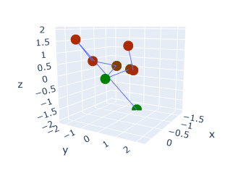
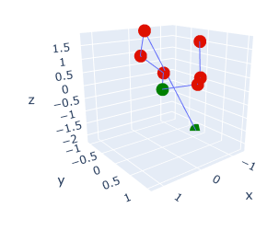
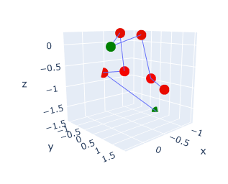
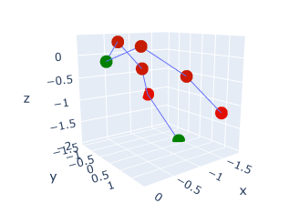
Recap
Different exercise types
The research question
Which models can be added to the OR-ensemble to improve the classification of individuals to the correct patient group using the existing data from a Flock of Birds system?
AB
AF
EL
RF

Slide 4
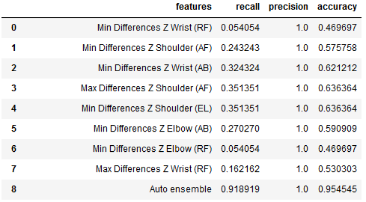
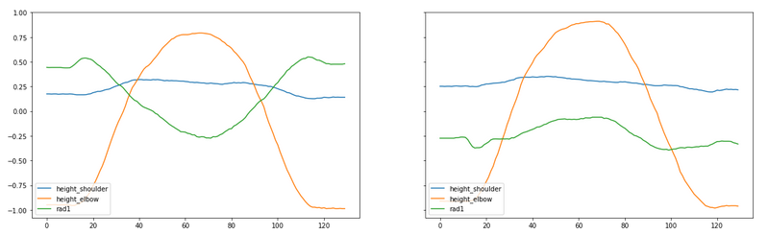
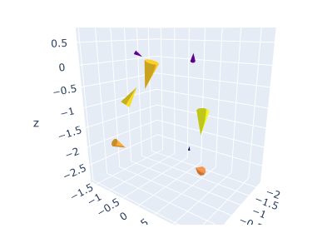
Last Week
Selected features for specific exercises
Reanalysed rotational data
Videocall with students Physiotherapy
Results of an experiment evaluating height differences for left and right arms
Plotting to spot differences in left and right side rotations
Plotting rotational data as directional vectors

Slide 5
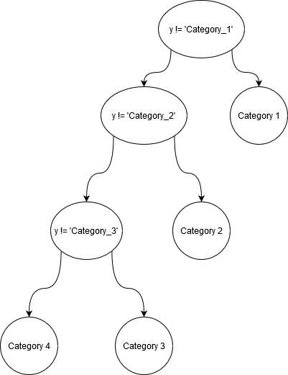
Figure out a way to differentiate between multiple categories in stead of only two

Slide 6
What will we do next?
Combining experiments from last week to add to the OR-ensemble
Do more experiments to select more features for specific exercise types
Retry to contact dr. de Groot

Slide 7
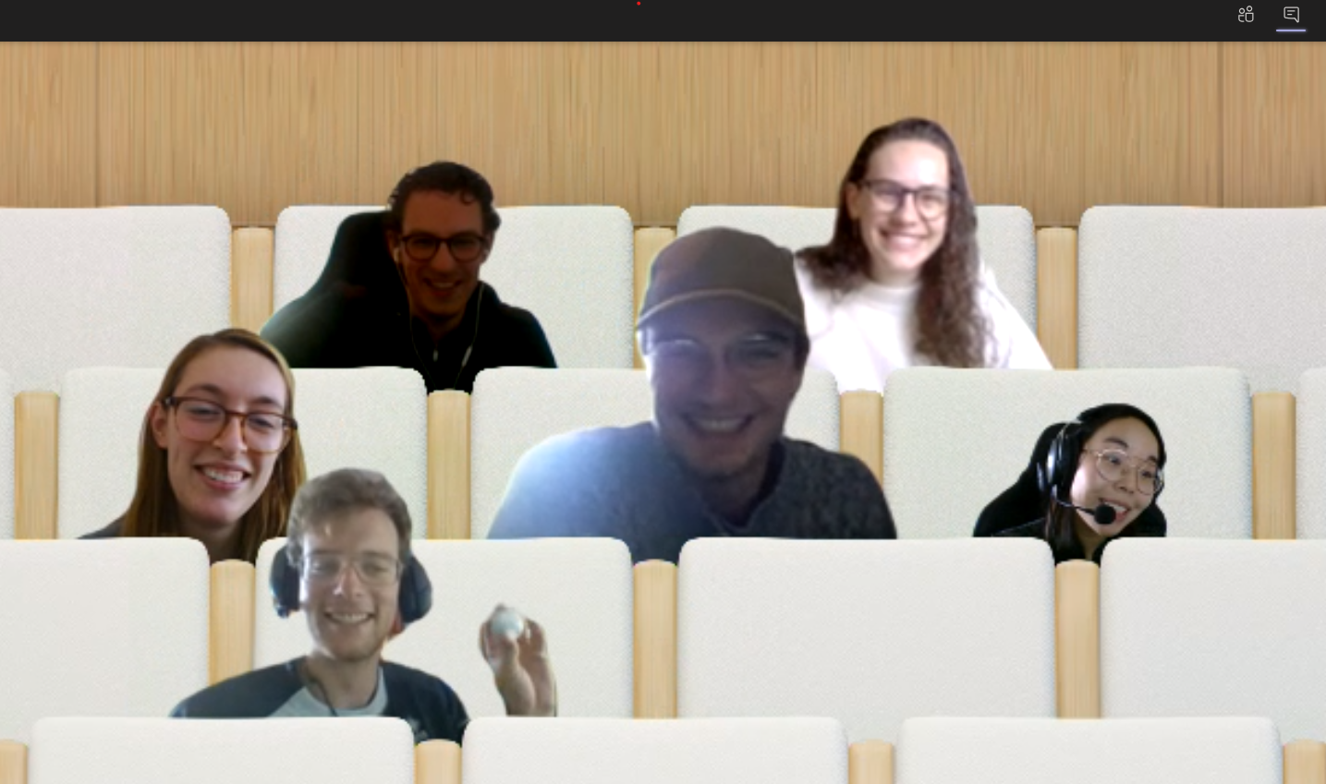
Questions?

